Slide 1
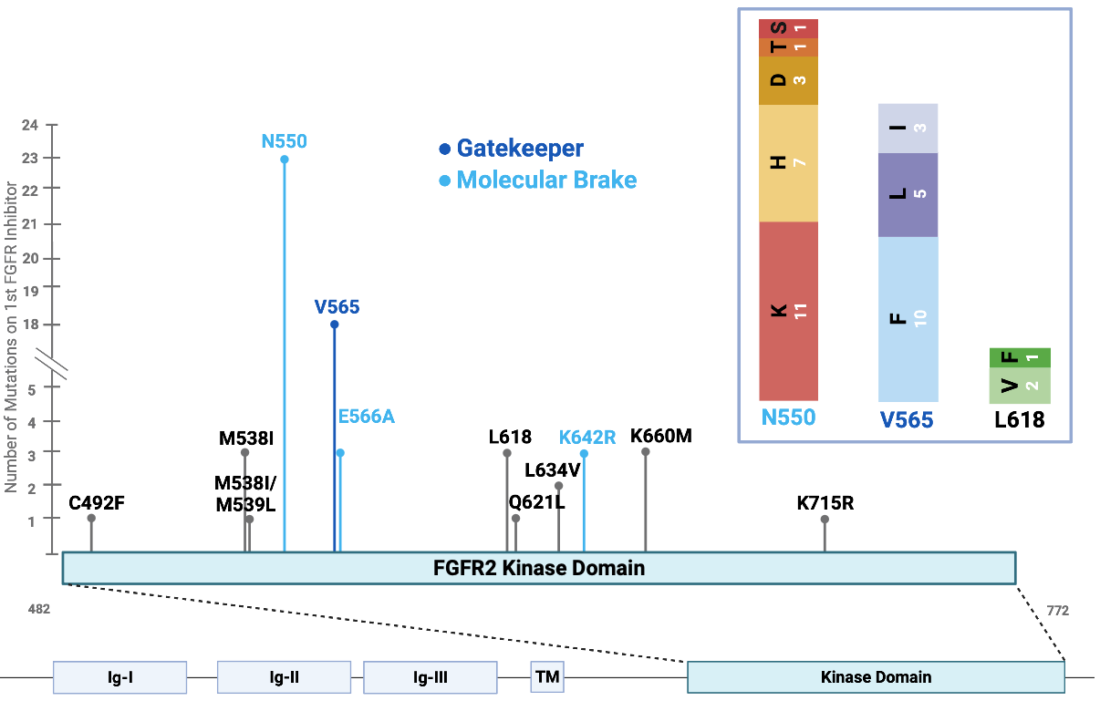
FGFR2 Kinase domain mutations
A568Y | L618V
C492C | L634V
D651H | M537I/M538L
D651Y | M538I
E566A | M539L
E566G | N550D
G543R | N550H
I549T | N550K
K527E | N550T
K642R | Q621L
K660M | S569F
K660N | V565E
K660Q | V565F
K715R | V565I
L551F | V565L
L618F | V565Y
L618M

